Slide 1
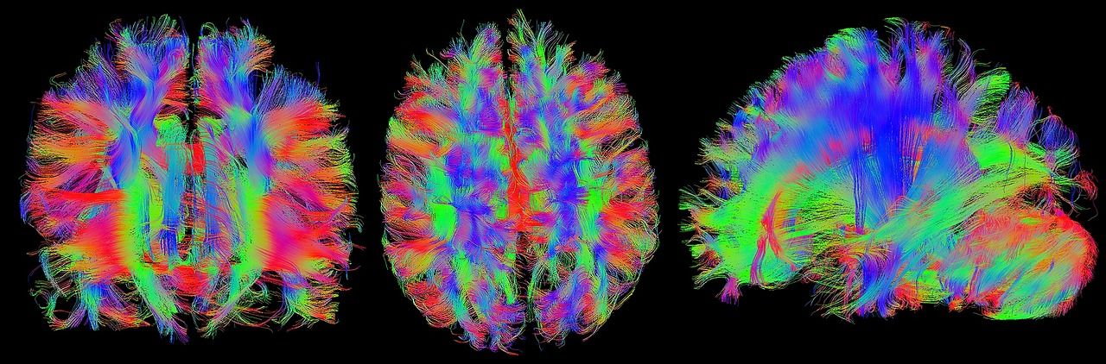

An overview on cognitive neuroscience
Francois Nadeau

Slide 2
3min speed intro on Memory fMRI, and coding -With a short experiment demo

Slide 3
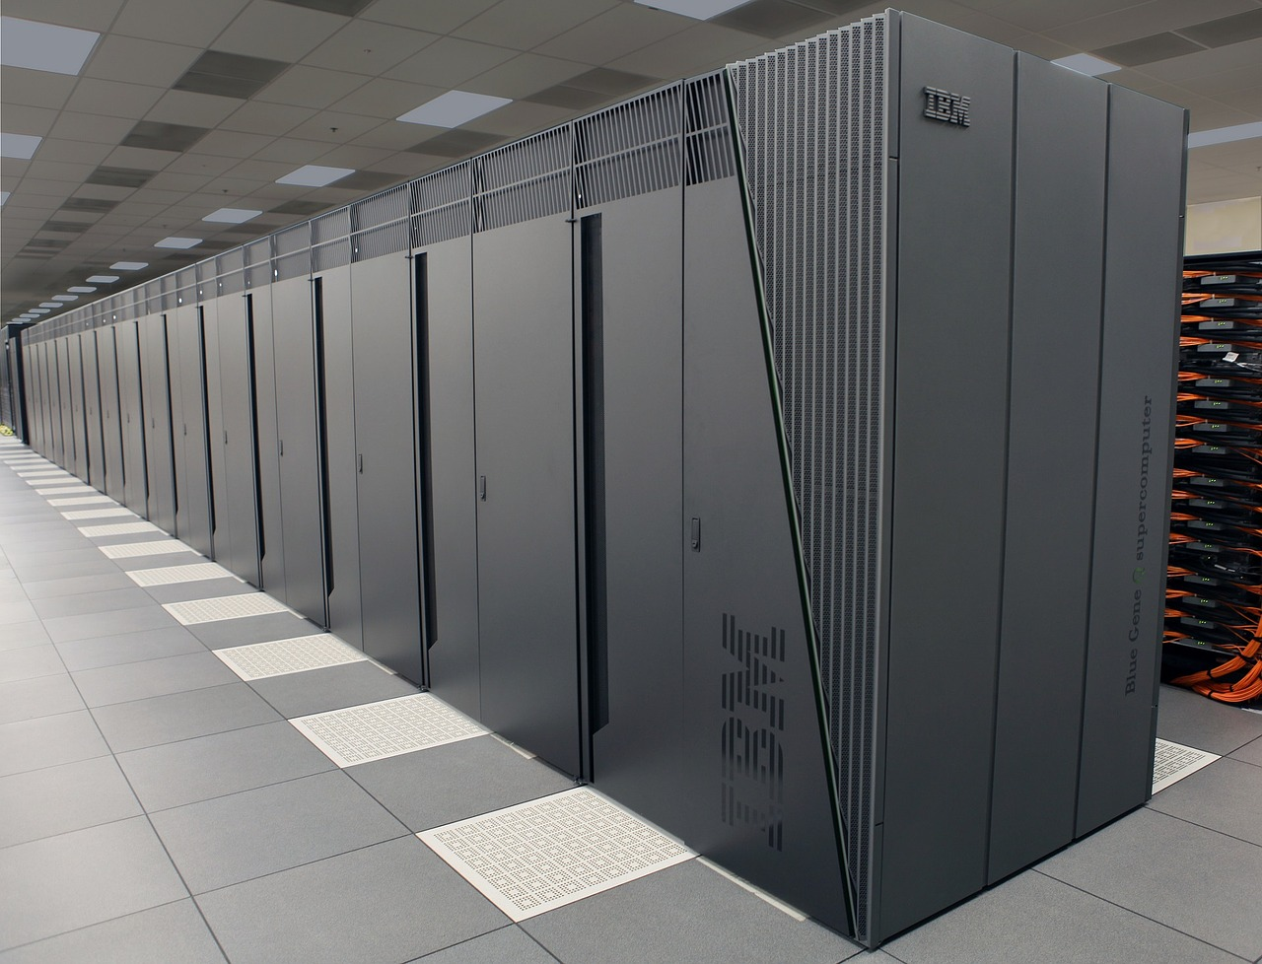
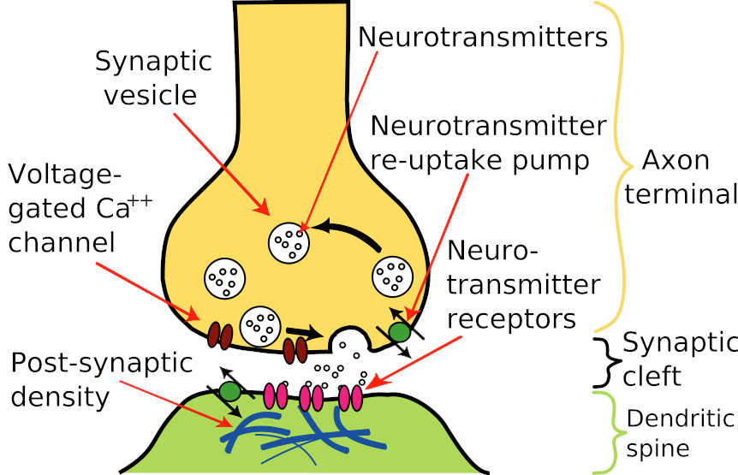
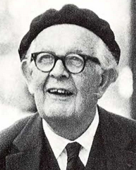
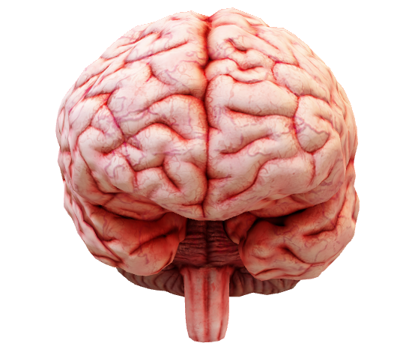

Slide 4
Psychology: Underlying cognitive processes of memory
Encoding
Storage
retrieval

Slide 5
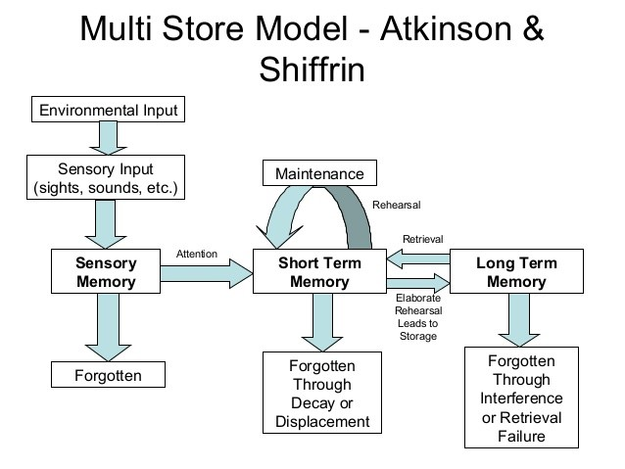
https://upload.wikimedia.org/wikipedia/commons/9/94/Information_Processing_Model_-_Atkinson_%26_Shiffrin.jpg

Slide 6
Quick fMRI Wrap up
neuroscience x physics: bold signal

Slide 7

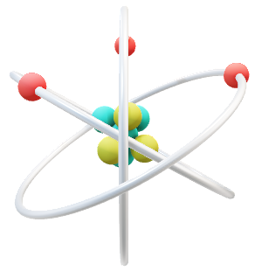
Oxy and Deoxyhemoglobin
➔Physics: Oxygenated (diamagnetic) and deoxygenated blood cells (paramagnetic) have different magnetic properties
➔Neuroscience: Activation/firing of neurons requires more energy, thus more blood (full of O₂ and glucose)
➔Brain activity can be indirectly measured!

Slide 8

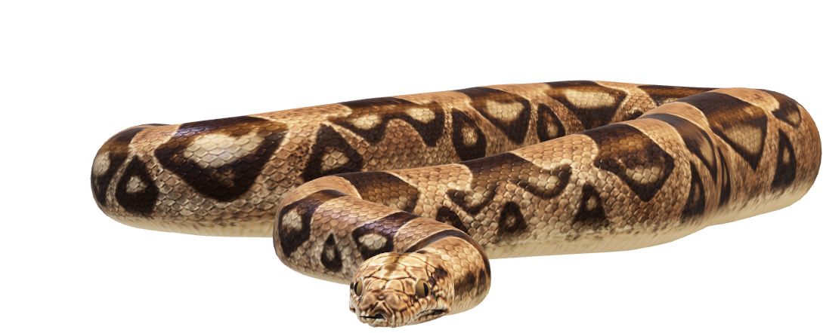
Coding
Get to python before python gets to you!

Slide 9


Learning to code helps to… Increase autonomy Save time and money Facilitates data reproductibility Being a cooler version of you

Slide 10
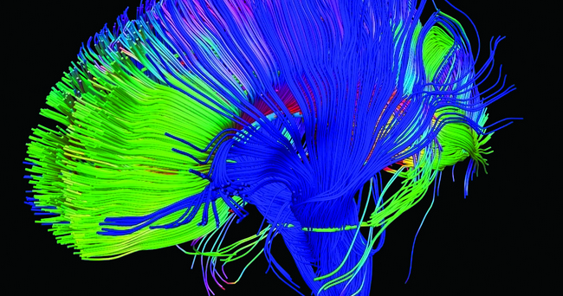
Link to my GitHub repository
https://github.com/mtl-brainhack-school-2019/memory_task_neuromod

